Slide 1
Week 10 Report for Systematic Literature Review
Oleg Ostapovich, Vladimir Klepikov, Mark Vishnevsky, Amir Zakirov, and Abdul Rahman Takriti

Slide 2
Goals for week 10
Methodology Revision and Fixes
Start to write Results section

Slide 3

Overall fixes
Now we have Overleaf file! (but still make pre-production into Google Docs)
Minor fixes for search queries, as braces

Slide 4
Methodology revision
Added numbers of papers for search queries
Added numbers for PRISMA diagram and PRISMA diagram created
Improved part with search process
Improved part with selection process

Slide 5
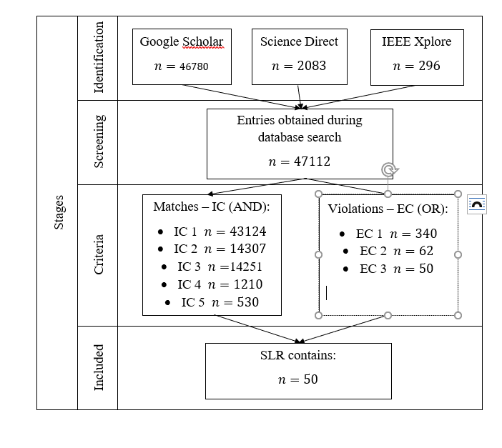
Diagram

Slide 6
Selection process
Query | Database | Result
("SLAM" AND "LIDAR" AND "CAMERA") AND ("UAV" OR "drone") AND ("mapping" OR "odometry") | Google Scholar | 82
 | Science Direct | 23
 | IEEE Xplore | 3
"SLAM" AND ("LIDAR" OR "CAMERA") AND ("UAV" OR "drone") AND ("mapping" OR "odometry") | Google Scholar | 155
 | Science Direct | 49
 | IEEE Xplore | 18
(("Odometry" OR "localization") AND ("mapping" OR "SLAM")) AND (("Camera" AND "lidar") AND ("imu" AND ("gnss" OR “gps”)) | Google Scholar | 128
 | Science Direct | 34
 | IEEE Xplore | 4
"SLAM" AND "LiDAR" AND "odometry" AND "UAV | Google Scholar | 40
 | Science Direct | 10
 | IEEE Xplore | 2
"LiDAR " AND "IMU” AND "CAMERA " AND "GNSS" AND ("SLAM" OR "LOCALIZATION") | Google Scholar | 119
 | Science Direct | 18
 | IEEE Xplore | 1

Slide 7
Results section
Improved research questions
Now it looks this way:
[RQ1]: What are the state-of-the-art SLAM methods with fused camera and lidar on UAV ?
[RQ2]: Which methods are used and needed for ground truth in localization and which are their benefits ?
[RQ3]: Which sensors and algorithms provide optimal efficiency in single-sensor usage and drawbacks of these methods?
[RQ4]: What problems will be encountered when using indoor solutions for localizing UAVs in an outdoors environment?

Slide 8
RQ1: What are the state-of-the-art SLAM methods with fused camera and lidar?
Starting from this inquiry we looked specifically for papers that illustrate the latest technologies of SLAM using the varied set of fused sensors such as LIDAR, Camera, IMU, GPS. During our search in databases, we found many studies focusing on SLAM as a whole topic, and others on either localization or mapping.
For these main three categories, we found that there are common patterns between the researchers in terms of the methodologies that they followed. In 7, 2, 1 the researchers attempted to utilize multi sensors such as IMU, LIDAR, Camera, but used different algorithms to integrate them together. The main difference detected is that unlike Mapping and Localization, there isn't a single study that focuses on utilizing a single sensor.
The idea of the aforementioned point is to show the importance of selecting the right algorithm as a major factor of determining the target of the sensor fusion process, notwithstanding that the same set is used in each different category.

Slide 9
And more and more and more
It is not cool to place all text into slides, so, lets go to out text

